Slide 1
Tutorial 8
T03/08
Goh Rui Zhi
gohruizhi@u.nus.edu

Slide 2
Announcements
Last Tutorial!!
Presentations coming up next ~~ Only need to come on the Week you are presenting!
NUS Well-being Day is on 5th Nov (Fri) …
Assignment 2 consultations:
1. 5th November (Fri) 3-5pm
2. 9th November (Tue) 2-4pm

Slide 3

Software security

Slide 4
Recap: Stack frame
0x000
Stack grows “downwards” (High address to low address)
New frame added with every function call
1. Arguments first placed on stack
2. Then the return address and previous frame’s base pointer/frame pointer
3. Finally your local variables are pushed onto the stack
*Note: Global variables/constants are stored elsewhere
Local Variables
Grows this way
Previous Stack/frame pointers
Return Address
Arguments
Previous Stack frames
0xFFF

Slide 5
Recap: Stack smashing
0x000
What if you have a buffer and you flood it?
All data on stack overwritten
Return address overwritten
When returning from function:
Pop previous stack/frame pointer address into a register
Pop return address into a register
Do return system call
Return to address ‘0x4141414141414141’ // Not valid address
**Error** - Segmentation fault
Buf = AAAAAAAAAAAAA AAAAAAAAAAAAAAAAAAAAAAAAAAAAAAAAAAAAAAAAAAAAAAAAAAAAAAAAAAAAAAAAAAAA
Grows this way
Write this way
Previous base pointer address
Return Address
Arguments
Previous Stack frames

Slide 6

Prevention
0x000
Introducing Canary!
A secret random value put onto the stack
Before return, will check if canary value is the same.
Throw error if overwritten and exit program (See question 1)
Need to know the exact value of canary to bypass the defence mechanism
Write back the exact canary to continue to corrupting stack
Very difficult to guess
Local Variables
Canary
Grows this way
Previous base pointer address
Return Address
Arguments
Previous Stack frames
0xFFF

Slide 7
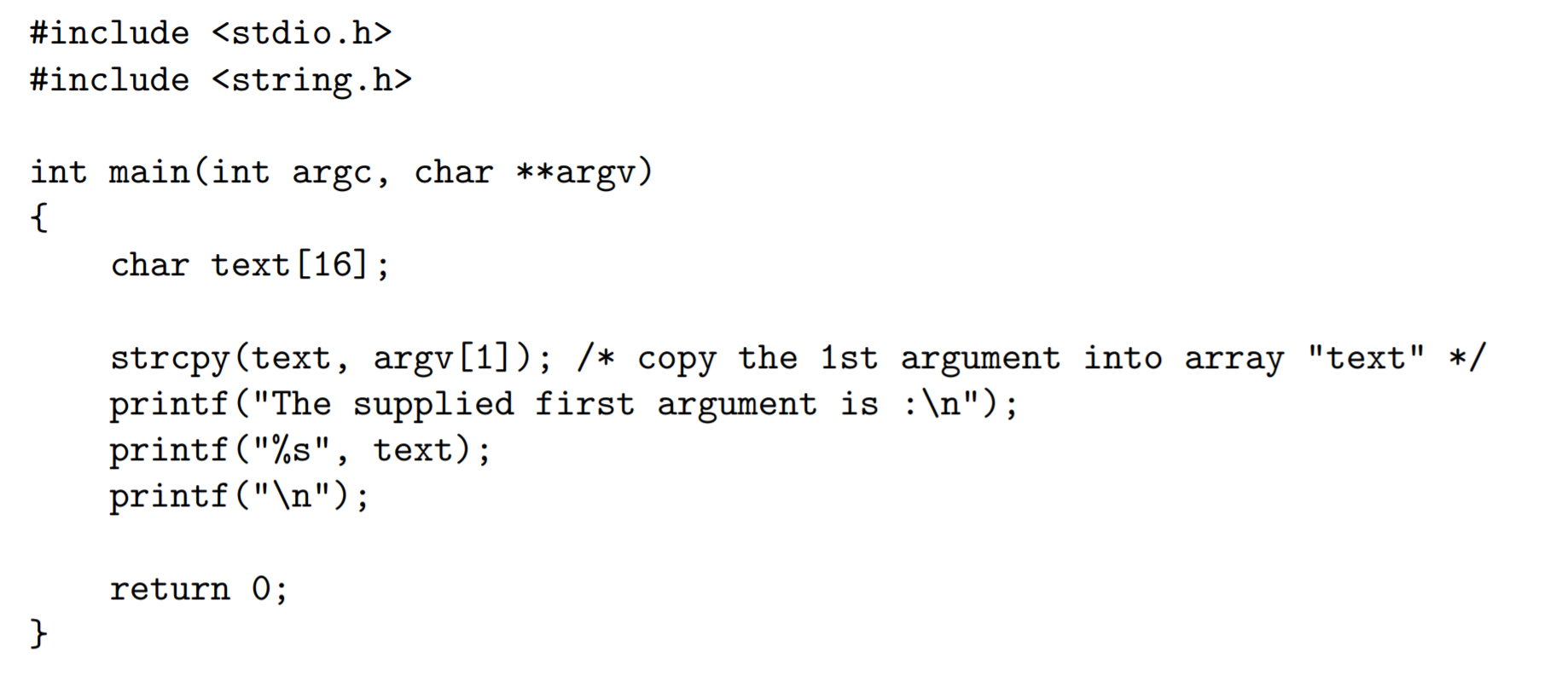
Question 1

Slide 8
Question 1
Try running the executable with the following arguments
a) two words
“two”. Program only prints argv[1]
b) ‘two words’
“two words”
c) <a very long string>
*** stack smashing detected ***: ./badprogram terminated Aborted (core dumped)
=> Buffer overflow which modified the Canary!

Slide 9
Question 2
Familiarize with UNIX/Linux Commands
ls: List the files & folders of current directory
cat: Prints the content of a file
sh: Starts a shell terminal to execute a command
echo: Prints its first argument

Slide 10
Question 3
Find out more about the following C libraries functions. Which usage should be avoided, and why?
(a) strcat (dest, source);
Unsafe. The buffer dest can get overflowed since there is no limit to the number of characters concatenated into it
(b) strncat (dest, source, n);
Safe if n < the remaining characters (bytes) available on the dest buffer.
(c) memcpy (dest, source, n);
Safe if n ≤ the sizes of the dest and source buffers

Slide 11
Question 3
(d) strncpy (dest, source, strlen(source));
Unsafe. The buffer dest can get overflowed since strlen(source) can be greater than dest’s length.
(e) sprintf (str, f);
Unsafe. The buffer str can get overflowed since the formatted string output can be longer than str’s length.
(f) printf ("Please key in your name: "); gets (str);
Unsafe. The buffer str can get overflowed since there is no limit to the number of characters read and stored into i

Slide 12
Question 3
(g) scanf ("%s", str);
Unsafe. The buffer str can get overflowed since there is no limit to the number of characters read and stored into it.
(h) scanf ("%20s", str);
Safe if the size of str > 20 since at most 20 characters are stored by scanf() into str.

Slide 13
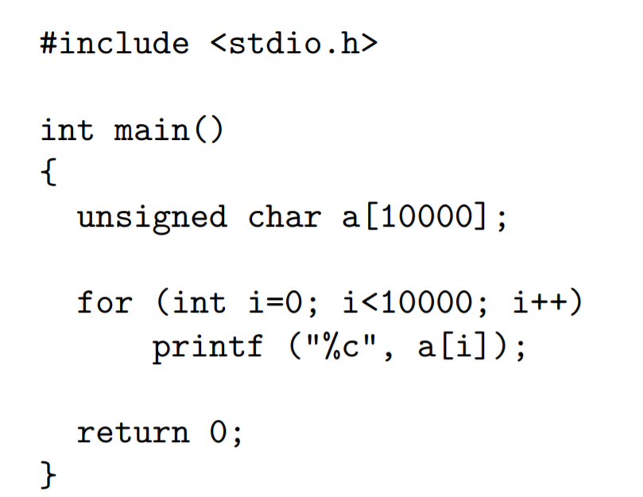
Question 4

Slide 14
Question 4
(a)
What would be the output?
Notice that a[10000] is not initialized. Hence, accessing an uninitialized variable leads to undefined behaviour. Bunch of random values displayed…
What is its implication to secure programming?
Risk:
What if the allocated region was previously used to store sensitive information?
Potential data leaks

Slide 15
Question 4
(b)
A possible preventive measure is to always initialize the array. What is the disadvantage of doing that?
Slow.
The bigger your array, the slower your start up will be.
Traversing array takes O(n) time

Slide 16
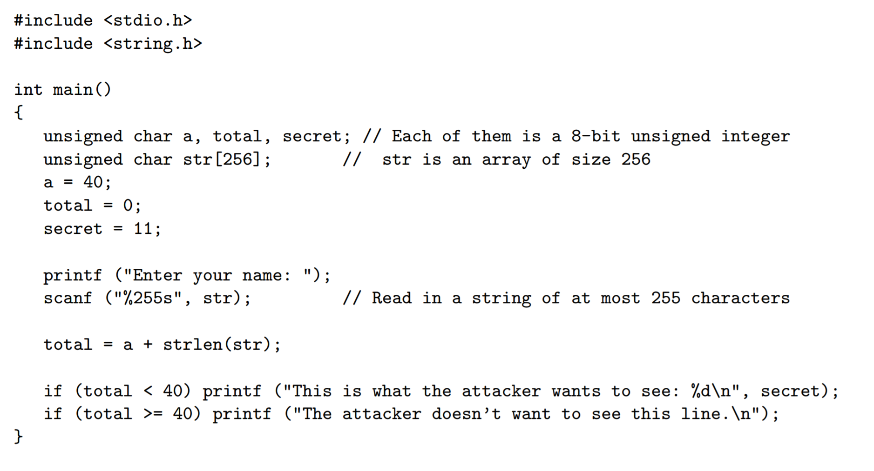
Question 5

Slide 17
Question 5
If the user follows the instruction and enters his/her name honestly, he/she will be unable to see the secret. Suppose you are the attacker, how would you cause the secret number to be displayed?
Notice that total is a 8-bit unsigned integer. Hence, its value ranges from 0 to 255.
What happens if I try to assign a value > 255 to total? => Integer overflow!
Result of total will be <value> mod(256)!
Just need to make <value>mod(256) < 40. Hence, we can supply a string with length 216 – 255 //

Slide 18
Question 6
As usual, please google the terms!

Slide 19

Thank you
Any questions?

